Slide 1
Discrete Time and Discrete Event Modeling Formalisms and Their Simulators
Dr. Feng Gu

Slide 2
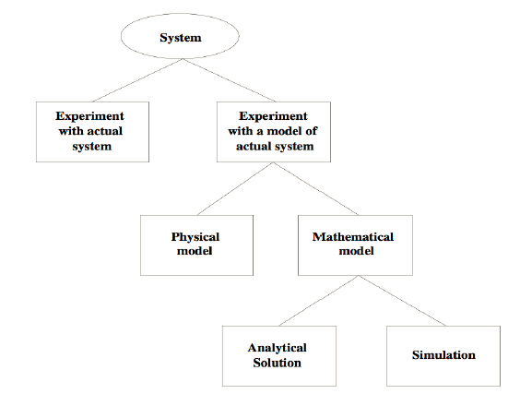
Way to study a system
Cited from Simulation, Modeling & Analysis (3/e) by Law and Kelton, 2000, p. 4, Figure 1.1

Slide 3
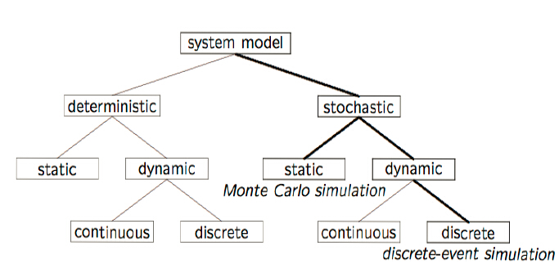
Model taxonomy

Slide 4
Modeling formalisms and their simulators
Discrete time model and their simulators
Differential equation models and their simulators
Discrete event models and their simulators

Slide 5
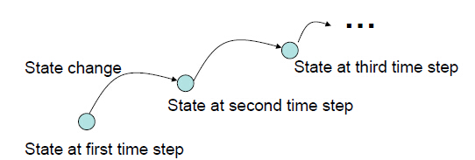
Discrete Time Models and Simulators
Discrete time models are usually the most intuitive to grasp all forms of dynamic models.
This formalism assumes a stepwise mode of execution.
At a particular time the model is in a particular state and it defines how its state changes. The next state usually depends on the current state and also what the environment’s influences currently are.

Slide 6
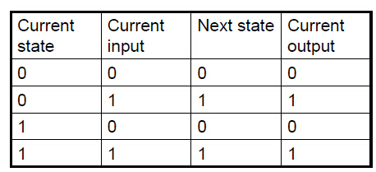
Discrete time model
Discrete time systems have numerous applications.
The most popular are in digital systems where the clock defines the discrete time steps.
It is also frequently used as approximations of continuous systems.
To build a discrete time model, we have to define how the current state and the input from the environment determine the next state of the model.
This can be done using a table.

Slide 7
Discrete time model
In discrete time models, time advances in discrete steps, which we assume are integer multiples of some basic period such as 1s, 1 day.
The transition/output table can also be described as follows: If the state at time t is q and the input at time t is x, then the state at time t+1 will be •(q,x) and the output y at time t will be λ(q,x).
Here • is called the state transition function and is the more abstract concept for the first three columns of the table. λ is called the output function.

Slide 8
Discrete time model
Question: specify •(q,x) and λ(q,x) for the table above •(q,x) = x λ(q,x) = x
The function •(q,x) and λ(q,x) are more general than the table.
Now add time in the above specification.

Slide 9
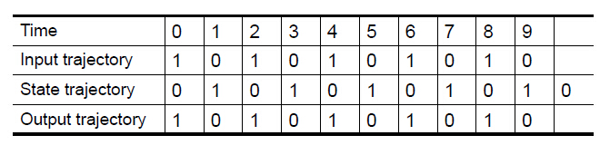
Discrete time model
A sequent of state, q(0), q(1), q(2),… is called a state trajectory. Having an arbitrary initial state q(0), subsequent states in the sequence are determined by
q(t+1) = •(q(t), x(t)) = x(t).
Similarly, a corresponding output trajectory is given by
y(t) = λ(q(t), x(t)) = x(t) .
Question: write an algorithm to compute the state and output trajectories of a discrete time model given its input trajectory and its initial state.

Slide 10
Discrete time model
The following algorithm is an example of a simulator for a discrete time model:
Ti=0, T_{f}=9 the starting and ending times, here 0 and 9
X(0) = 1, …, x(9) = 0 the input trajectory
q(0) = 0 the initial state
t=T_{i}
While (t<=T_{f}){
y(t) = λ(q(t), x(t))
q(t+1) = δ(q(t), x(t))
t = t+1
}
Question: The computation complexity of this algorithm/

Slide 11
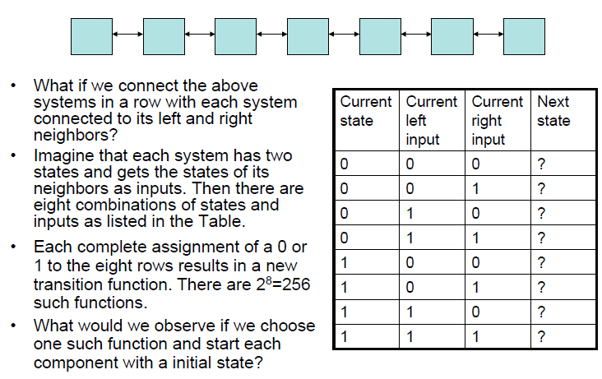

One-dimensional cell space

Slide 12
Cellular automata
A cellular automaton is an idealization of a physical phenomenon in which space and time are discredited and the state sets are discrete and finite.
Cellular automata have components, called cells, which are all identical with identical computational apparatus.
They are geometrically located on a one-, two-, or multidimensional grid and connected in a uniform way.
The cells influencing a particular cell, called the neighborhood of the cell, are often chosen to be the cells located nearest in the geometrical sense.
Time is also discrete, and the state of a cell at time t is a function of the states of a finite number of cells (called its neighborhood) at time t − 1. Each time the rules are applied to the whole grid a new generation is created.
Cellular automata were originally introduced by von Neumann and Ulam as idealization of biological self-production.

Slide 13
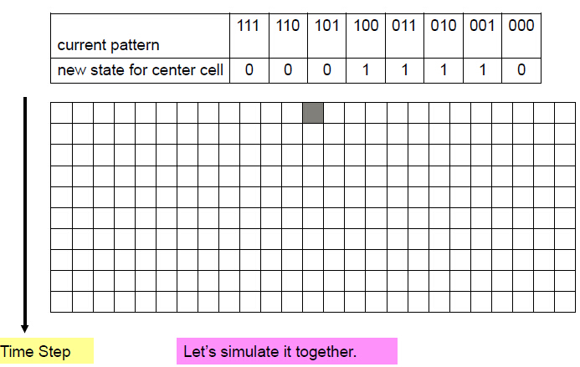

Example of CA

Slide 14
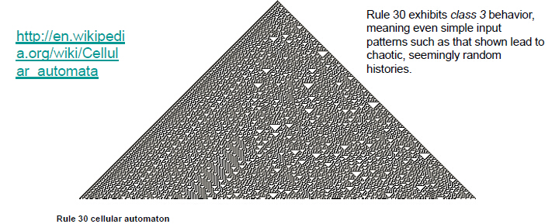
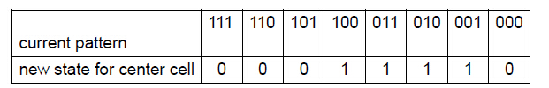
One dimensional cellular automata
Below are tables defining the "rule 30 CA" and the "rule 110 CA" (in binary, 30 and 110 are written 11110 and 1101110, respectively) and graphical representations of them starting from a 1 in the center of each image:

Slide 15
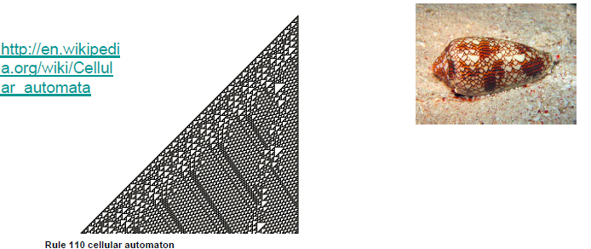
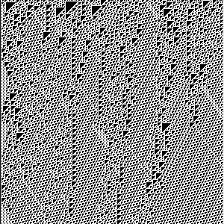
One dimensional cellular automata
Rule 110, like the Game of Life, exhibits what Wolfram calls class 4 behavior, which is neither completely random nor completely repetitive. Localized structures appear and interact in various complicated-looking ways.

Slide 16
One dimensional cellular automata
Rule 30 CA
http://modelingcommons.org/browse/one_model/1564#model_tabs_browse_applet
Rule 110 CA
http://modelingcommons.org/browse/one_model/1562#model_tabs_browse_applet

Slide 17
Cellular automata
Wolfram systematically investigated all possible transition functions of one-dimensional cellular automata.
He found out that there exist four types of cellular automata that differ significantly in their behavior:
-Automata where any dynamic soon die out.
-Automata that soon come to periodic behavior
-Automata that show chaotic behavior
-And the most interesting ones, automata whose behaviors are unpredictable and non-periodic but that showing interesting, regular patterns.

Slide 18
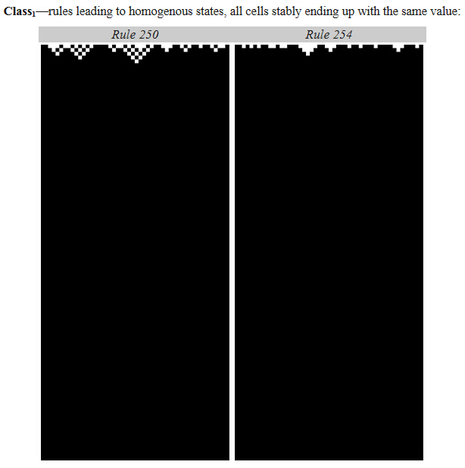
Class 1

Slide 19
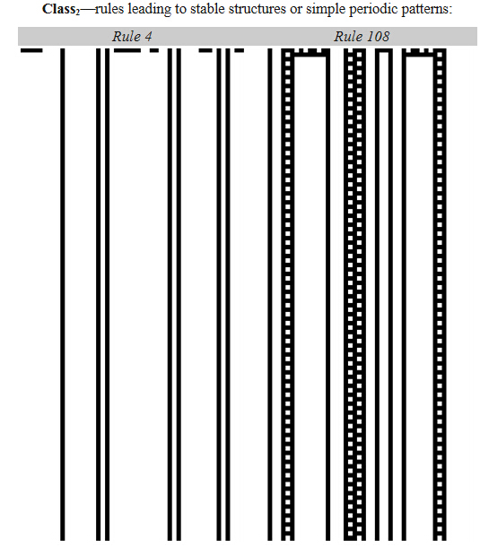
Class 2

Slide 20
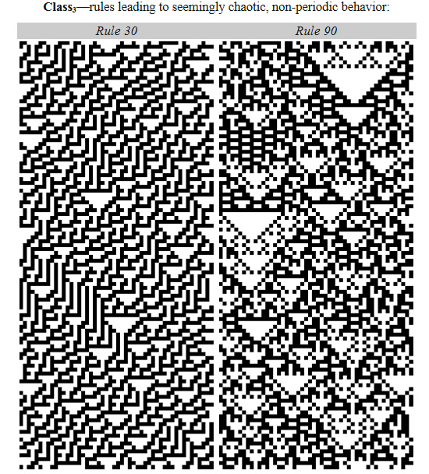
Class 3

Slide 21
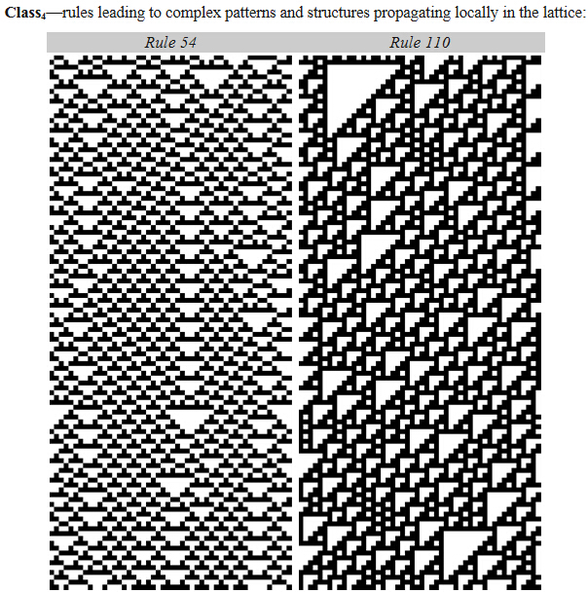
Class 4

Slide 22
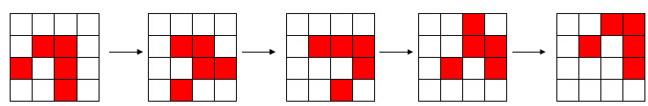
Game of life
Conway’s Game of Life is framed within a two-dimensional cell space structure
Each cell is in one of two possible states, live or dead. Every cell interacts with its eight neighbors, which are the cells that are directly horizontally, vertically, or diagonally adjacent. At each step in time, the following transitions occur:
-Any live cell with fewer than two live neighbors dies, as if by loneliness.
-Any live cell with more than three live neighbors dies, as if by overcrowding.
-Any live cell with two or three live neighbors lives, unchanged, to the next generation.
-Any dead cell with exactly three live neighbors comes to life.

Slide 23
Game of life
http://en.wikipedia.org/wiki/Conway's_Game_of_Life
http://www.bitstorm.org/gameoflife
http://math.com/students/wonders/life/life.html

Slide 24
Why is game of life interesting
(http://math.com/students/wonders/life/life.html)
It is one of the simplest examples of what is sometimes called "emergent complexity" or "self-organizing systems."
It is the study of how elaborate patterns and behaviors can emerge from very simple rules. It helps us understand, for example, how the petals on a rose or the stripes on a zebra can arise from a tissue of living cells growing together. It can even help us understand the diversity of life that has evolved on earth.
In Life, as in nature, we observe many fascinating phenomena. Nature, however, is complicated and we aren't sure of all the rules. The game of Life lets us observe a system where we know all the rules.
The rules described above are all that's needed to discover anything there is to know about Life, and we'll see that this includes a great deal. Unlike most computer games, the rules themselves create the patterns, rather than programmers creating a complex set of game situations.

Slide 25
Cellular automata simulation algorithm
How to develop a CA simulation algorithm?
The basic procedure for simulating a cellular automaton follows the discrete time simulation algorithm introduced earlier.
At every time step we scan all cells, applying the state transition function to each, and saving the next state in a second copy of the global state data structure.
Then the clock advances to the next step.
To do this we need to limit the space to a finite region.
How to take care of the boundary cells?
What is the computation complexity of this algorithm?

Slide 26
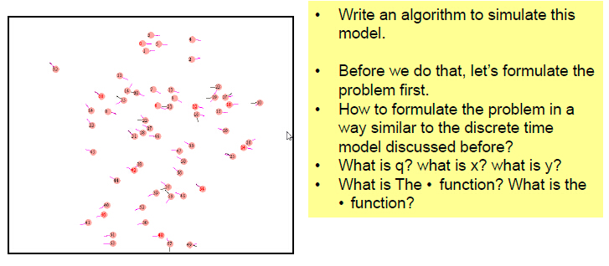
Discussion
Now consider an agent-based pedestrian crowd simulation. At each time step, each agent makes an decision of movement (based on its current state and its surrounding situation) and then carry out the movement.

Slide 27
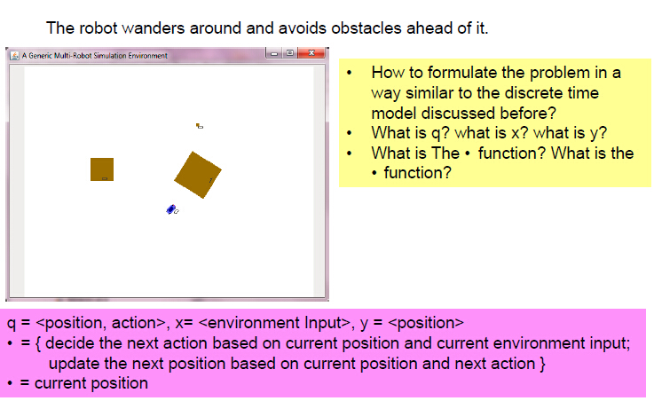
Discussion

Slide 28
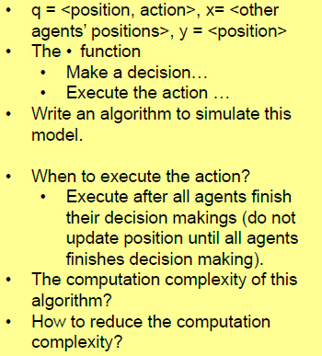
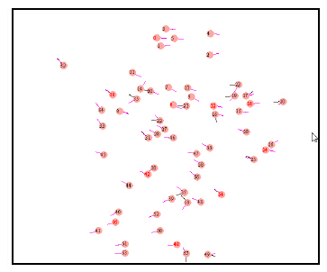
Discussion
Now consider an agent-based pedestrian crowd simulation. At each time step, each agent makes an decision of movement (based on its current state and its surrounding situation) and then carry out the movement.

Slide 29
Cellular automata simulation algorithm
The basic procedure for simulating a cellular automaton follows the discrete time simulation algorithm introduced earlier.
At every time step we scan all cells, applying the state transition function to each, and saving the next state in a second copy of the global state data structure.
Then the clock advances to the next step.
What is the computation complexity of this algorithm?
A more efficient approach?

Slide 30
Discrete event approach to cellular automata simulation
In discrete time systems, at every time step each component undergoes a “state transition”; this occurs whether or not its state actually changes.
Often, only small number of components really change.
Define an event as a change in state (e.g.., births and deaths in the Game of Life).
A discrete event simulation algorithm concentrates on processing events rather than cells and is inherently more efficient.
How to design the algorithm?

Slide 31

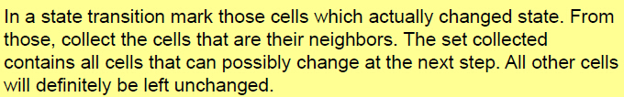
Discrete event approach to cellular automata simulation
The basic idea is to try to predict whether a cell will possibly change state or will definitely be left unchanged in the next global state transition.
A cell will not change state at the next state transition time, if none of its neighboring cells changed state at the current state transition time.
Why?

Slide 32
Discrete event approach to cellular automata simulation
In a state transition mark those cells which actually changed state. From those, collect the cells that are their neighbors. The set collected contains all cells that can possibly change at the next step. All other cells will definitely be left unchanged.
Question: Analyze the computation complexity of this discrete event approach for cellular automata simulation.

Slide 33
Discrete event model
Discrete event models have many applications. Examples:
-Queue Model (Example: the service lines in a bank)
-Process workflow system such as manufactory system, supply chain
-Control systems (Example: rail road dispatch control)
-Ecological systems with the happenings of significant phenomenon (such as occurrence of a fire)
-Computer networks (driven by arrival of packages or completion of tasks)
-Any system where the concept of “change” is important even they are traditionally modeled by continuous models or discrete time models. (Example: decision making of a human being driven by changes in perception).
Discrete time model is a special case of discrete event model with each time step as an event.

Slide 34
A cellular automata with fitness
The original version of Game of Life assumes that all births and deaths take the same time (equal to a time step)
A more accurate representation assumes birth and death dependent on a quantity called fitness.
A cell attains positive fitness when its neighborhood is supportive, that is, when it has exactly 3 neighbors, and the fitness will diminish rapidly when its environment is hostile (<2 or >3 neighbors).
Whenever the fitness reaches 0, the cell will die. A dead cell will have a negative fitness -2. When the environment is supportive and the fitness crosses the zero level, the cell will born.
Assuming the fitness increase rate is 1 per second, decrease rate is -3 per second. A cell can have maximum fitness of 6.

Slide 35
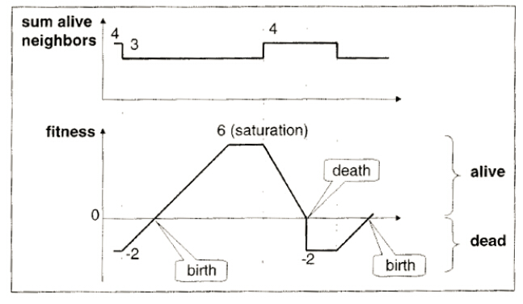
An example
What is needed to model such a process?

Slide 36
Discussion
Discrete Time Modeling approach
-What are the q, x, y, delta function, and output function?
-(fitness should be part of q)
Discrete Event Modeling approach
-Consider one cell first
-Then the whole cell space
For the discrete time model, what happens if the birth or death time is not integer?

Slide 37
Event-based approach
Concentrate on the interesting events only, namely births and deaths, as well as the changes in the neighborhood.
To do that, we need a means to determine when interesting things happen.
Events can be caused by the environment, such as the changes of the sum of alive neighbors. The occurrence of such external events are not under the control of the model component itself.
On the other side, the component may schedule events to occur. Those are called internal events.
Given a particular state, e.g., a particular fitness of the cell, a time advance is specified as the time it takes until the next internal event occurs, supposing that no external event happens in the meantime.

Slide 38
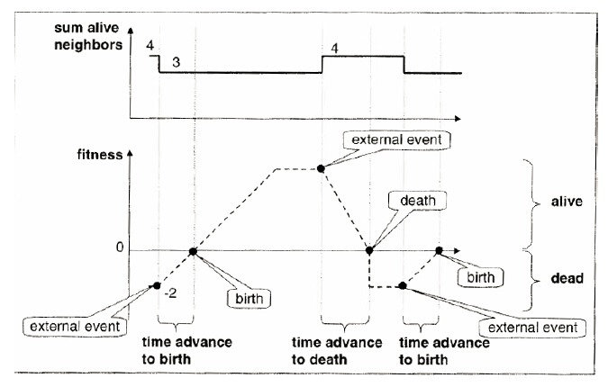
The example

Slide 39
Scheduling
How does time advance in a discrete time model and a discrete event model?
The concept of “scheduling” is central in discrete event modeling and simulation.
In a discrete time model, scheduling is implicit because the time advances in a fixed time step fashion.
In a discrete event model, at any state, the model needs to explicitly schedule the next event.
-Given a particular state, a time advance is specified as the time it takes until the next internal event occurs, supposing that no external event happens in the meantime.

Slide 40
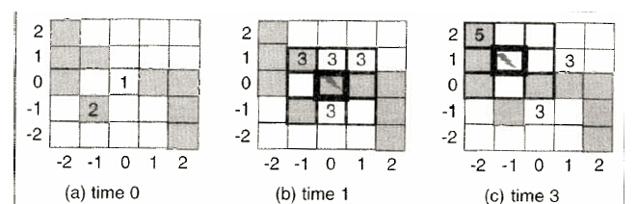
Discrete event simulation
In discrete event simulation, one has to execute the scheduled internal events of the different cells at their event times.
Moreover, at any state change through an internal event we must take care to examine the cell’s neighbors for possible state changes.
A change in state may affect waiting times as well as result in scheduling of new events and cancellation of events.

Slide 41
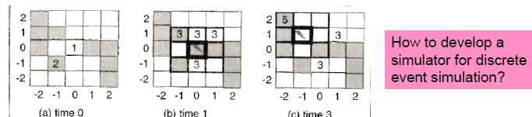
Discrete event simulation
We see that the effect of a state transition may not only be to schedule new events, but also to cancel events that were scheduled in the past. (see from (a) to (b) in the figure)
Furthermore, see from (b) to (c) in the figure, the system can jump from the current time 1 to next event time 3. This illustrates efficiency advantage in discrete event simulation – during times when no events are scheduled, no components need to be scanned.
The situation at time 3 (Figure (b) also illustrates a problem in discrete event simulation – that of simultaneous events.
Who goes first?
-All simultaneous events undergo their state transitions together.
-Define a priority among the components

Slide 42
Event scheduling
Event scheduling is a basic approach in discrete event simulation.
Because of its simplicity, event scheduling simulation is the preferred strategy when implementing customized simulation systems in procedural programming languages.
The event scheduling utilizes a event list, which stores a list of events that are ordered by increasing scheduling times.
The event with earliest scheduled time is removed from the list and the clock is advanced to the time of this imminent event. The routine associated with the imminent event is executed.
A tie-breaking procedure is employed if there is more than one such imminent events.
Execution of the event routine may cause new events to be added in the proper place on the list. Also, existing events may be rescheduled or even canceled.
The next cycle now begins with the clock advance to the earliest scheduled time.

Slide 43
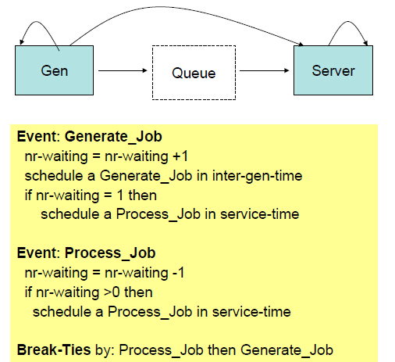
Event scheduling

Slide 44
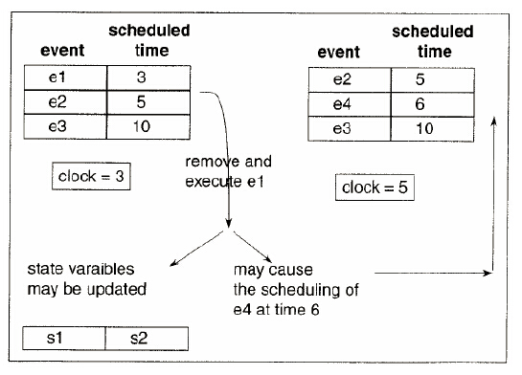
Event scheduling

Slide 45
Event list scheduling
Exercise: Hand execute the simulation algorithm for several cases: for example (1) inter-gen-time > service-time; (2) inter-gen-time = service-time; (3)inter-gen-time <service-time <2*inter-gen-time

Slide 46
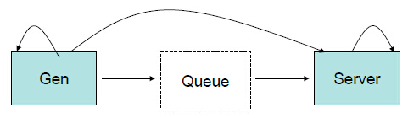
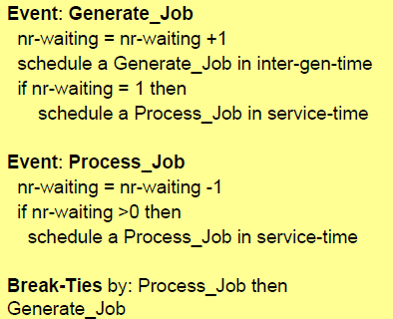

Discussion

